Slide 1
CSET301 – AI-ML
Lecture 6 : Logistic Regression

Slide 2
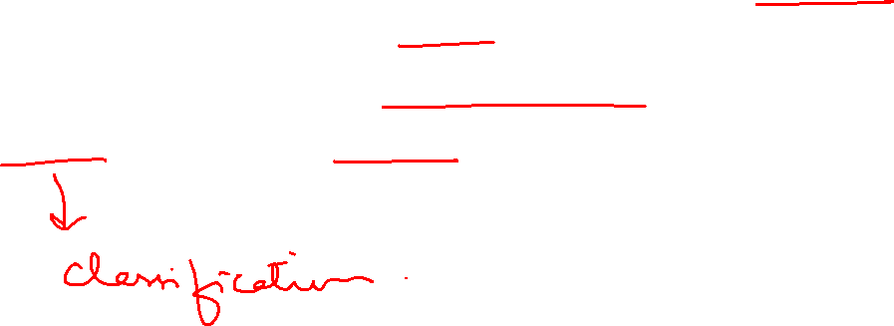
Linear regression and Logistic Regression
Linear regression and logistic regression are both supervised learning algorithms, but they are used for different types of problems.
Linear regression predicts continuous numerical values, while logistic regression predicts the probability of a binary outcome

Slide 3
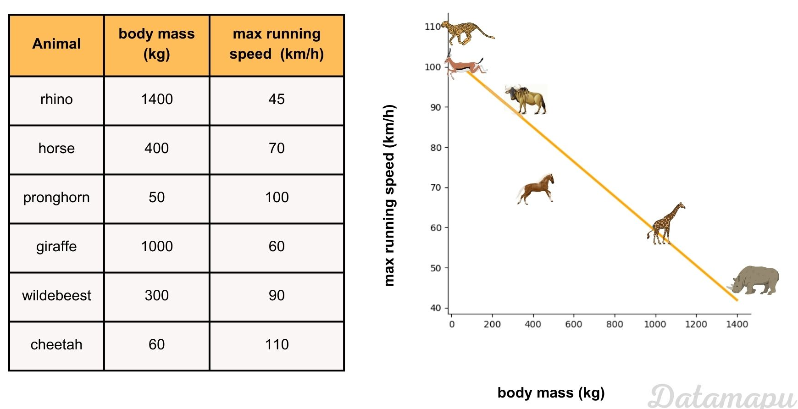
Linear regression and Logistic Regression
Linear Regression: Outputs a continuous value

Slide 4
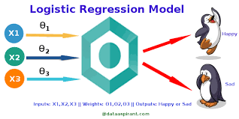
Linear regression and Logistic Regression
Logistic Regression: Outputs a probability between 0 and 1

Slide 5
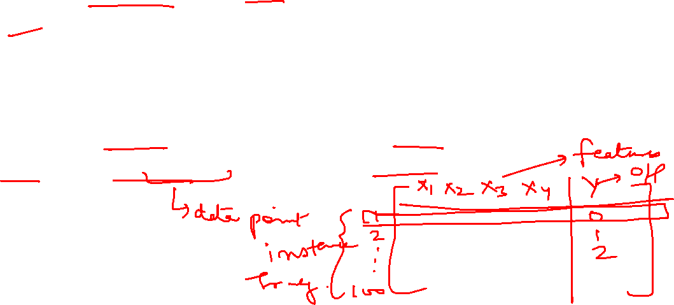
Logistic Regression
Logistic regression is defined as a supervised machine learning algorithm that accomplishes binary classification tasks by predicting the probability of an outcome
Analyzes the relationship between one or more independent variables and classifies data into discrete classes.
It is used in predictive modeling, where the model estimates the mathematical probability of whether an instance belongs to a specific category or not.

Slide 6
Logistic Regression
Used when the dependent variable is categorical.
0 – represents a negative class; 1 – represents a positive class.
Used in binary classification problems where the outcome variable reveals either of the two categories (0 and 1).
Example: Predicting whether an email is spam or not. Spam category is positive class (1), and not spam is negative class (0). Output: A probability value between 0 and 1, representing the likelihood of the positive class.

Slide 7
Logistic Regression
Examples:
Determine the probability of heart attacks: Using logistic model, medical practitioners can determine the relationship between variables such as the weight, exercise, etc., of an individual and use it to predict whether the person will suffer from a heart attack or any other medical complication.
Identifying spam emails: Email inboxes are filtered to determine if the email communication is promotional/spam by understanding the predictor variables and applying a logistic regression algorithm to check its authenticity.

Slide 8
Types of Logistic Regression
Binomial Logistic regression: 2 possible outcomes. Ex: spam or not spam
Multinomial logistic regression: 3 or more categories but no order. Ex: Predicting which food is preferred more: Veg, Non-Veg, Vegan
Ordinal Logistic regression: 3 or more categories with order. Ex: Movie rating from 1 to 5.

Slide 9
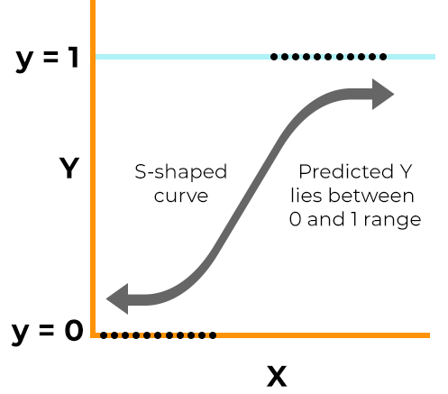
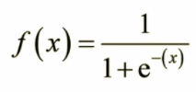
Logistic Regression Equation
Logistic regression uses a logistic function called a sigmoid function to map predictions and their probabilities.
The sigmoid function refers to an S-shaped curve that converts any real value to a range between 0 and 1.
Where e = base of natural logarithm
X = value we want to transform

Slide 10
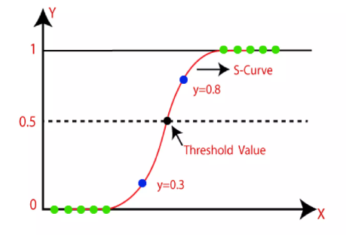
Logistic Regression Equation
If the output of sigmoid function is more than 0.5, we classify the outcome as 1 or Yes.
If the output of sigmoid function is less than 0.5, we classify the outcome as 0 or No.

Slide 11
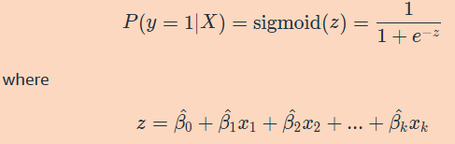

Logistic Regression
Lets say you are given inputs X=(x₁, x₂, ... , x_{k}) and outcome y falls into one of two categories (say 0 or 1)
The following equation is used to estimate the probability of y:
This is called a linear predictor, and it is transformed by the sigmoid function so that the values fall between 0 and 1,
And can therefore be interpreted as probabilities. This resulting probability is then compared to a threshold to predict a class for y based on X.

Slide 12
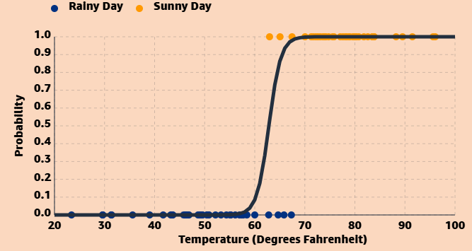
Logistic Regression Example
Suppose that you want to go for a hike in Seattle. You want to predict whether it will be sunny or rainy, so that you can decide whether to hike or drink coffee indoors at a local cafe. You know that it rains often in Seattle, but you’ve heard the summers have nice weather. The question is: can we predict the weather, given factors such as the temperature?
Suppose we have two classes:
Rainy (0) and Sunny (1)
One continuous feature: Temperature

Slide 13
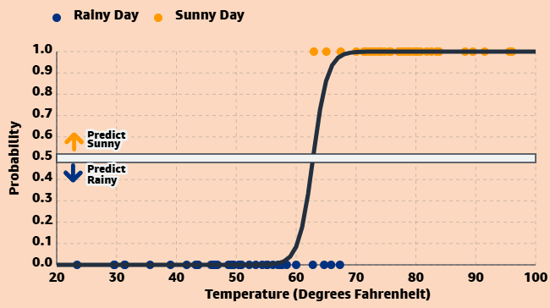
Logistic Regression Example
For data like this, we should clearly not fit a linear regression model.
The outcome of linear regression can take any numerical value.
But here the data can take outcome as either 0 or 1, so the predictions of linear regression may not be meaningful.
Instead, logistic regression should be used. Value of this function can be interpreted as probabilities.

Slide 14
Thank You

